Slide 1

LOAN PREDICTION MODEL
Beta Signal -Group 2 mini project models an analysis of the borrower’s eligibility/chances of being granted a loan based on their record

Slide 2


Objectives
Provide an automation of loan processing system for financial institutions
Help save time for financial institutions when checking if a client qualifies for the loan
Binary response of the target variable, that is, loan approval status

Slide 3
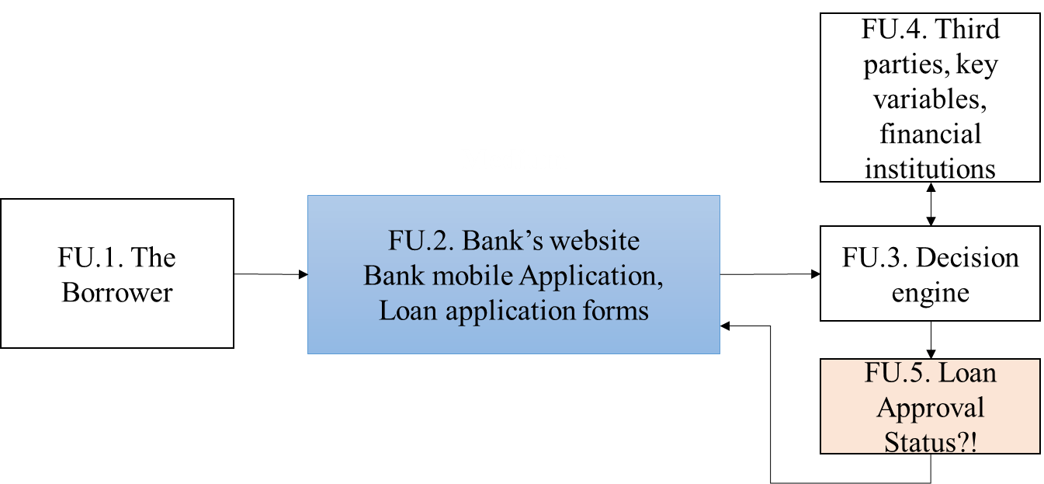
Business understanding
increased need for consumer credit.
Customer Eligibility
loan shopping process.
Business Process

Slide 4
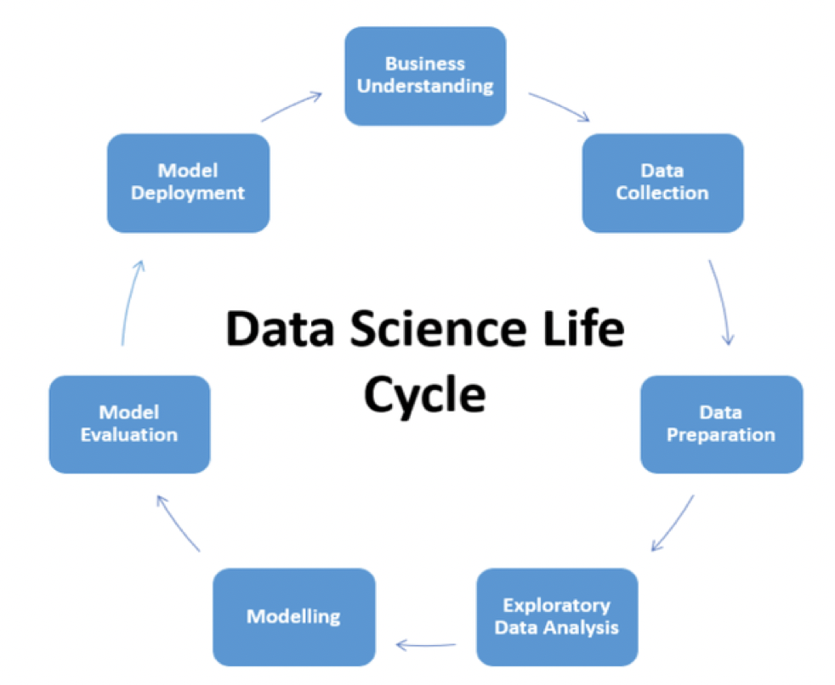
Model development approach
Data science life cycle
Ref: https://medium.com/swlh/complete-life-cycle-of-a-data-science-machine-learning-project-13df81bbd8eb

Slide 5
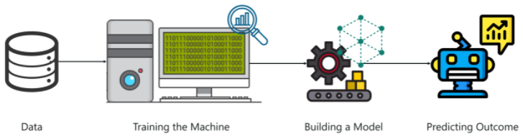
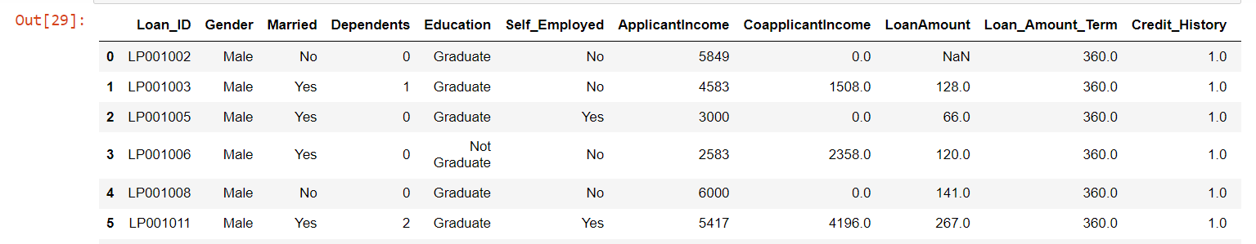
Model development Process
Dataset snippet in our Jupiter Notebook

Slide 6
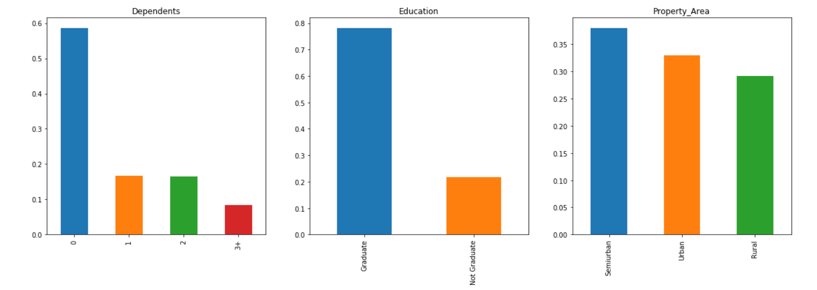
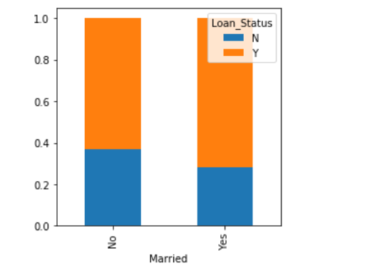
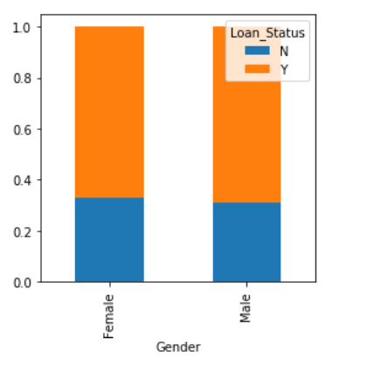
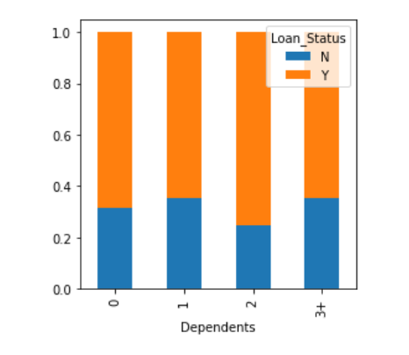
Exploratory data analysis
Analyzing data
using graphs

Slide 7
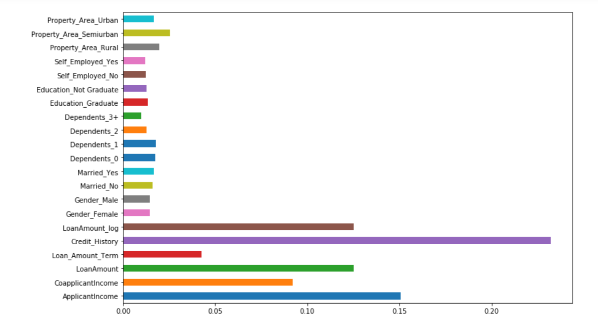
Feature importance

Slide 8
Model validation
Accuracy
Logistic regression = 78%
Random forest = 77%
After important features, we retrained our model, Accuracy
Logistic regression = 83%.
Random forest = 81%

Slide 9
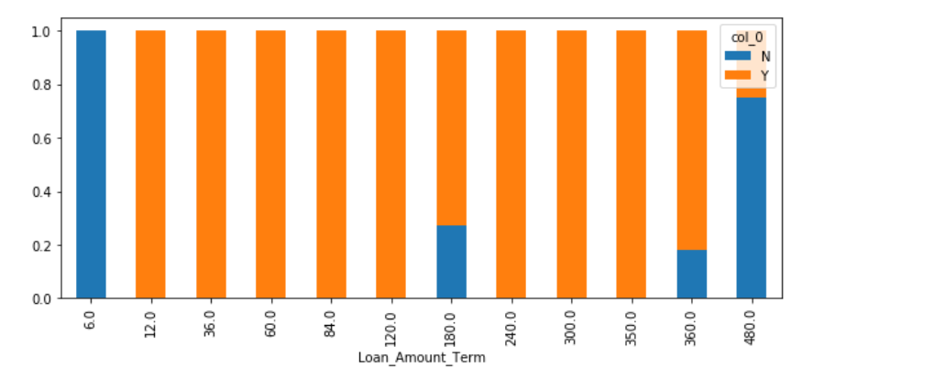
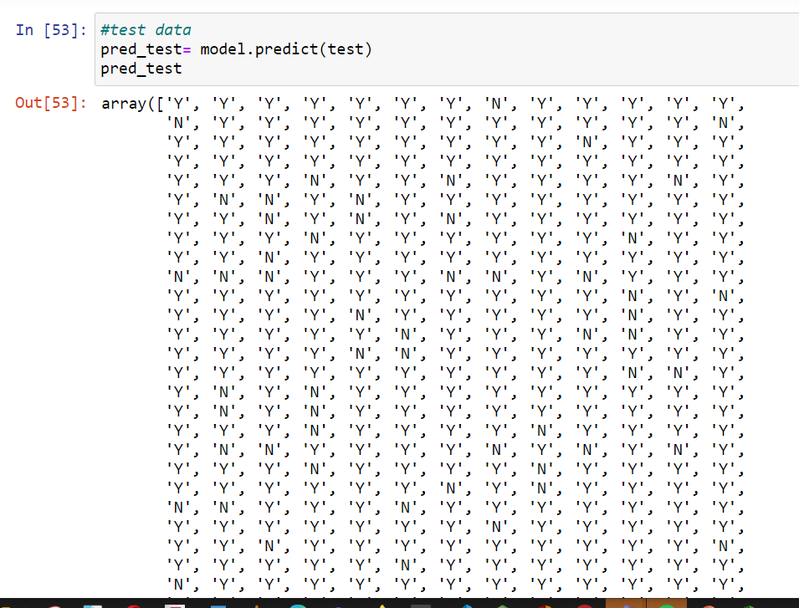
Beta Signal
Results

Slide 10

Conclusion
Loan processing model was created & used to check the eligibility of the borrower to qualify for a loan based on their record.
Applicants with no credit history have almost 100% chance of their loan applications declined.
Model development requires continuous improvement. Data cleaning & variable engineering/feature importance contributes to model accuracy.
Prediction models quicken the loan application & reduce the risk of approving applicants likely to default on their payments
Thank You
Questions

